Slide 1
LCCC Computer Science
Laramie County community college
Classes and Object-Oriented Programming

Slide 2
“The Tools”
Variables
I/O (simple)
Boolean Expressions (If), Conditionals
Loops
Arrays and their cousins
Functions
  Arguments
  Return Values and Void functions (side effects)
Frameworks and Libraries
Objects and classes

Slide 3
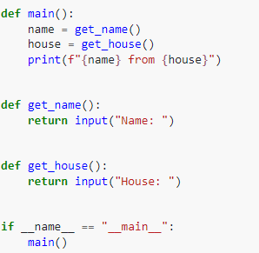

Our Abstraction Journey (so far)
Procedural, step-by-step paradigm: Much like you have seen in prior parts of this course.
We can create functions to abstract away parts of this program. Note here how we start to move our main ‘flow’ into ‘main()’

Slide 4
What is a class?
Think of Classes as code recipes for creating these things called Objects.
  They are useful because they allow us to save Objects with a combination of properties and functions.
  This in turn simplifies coding as all of the information and operations needed for particular topics are accessible from the same place.

Slide 5
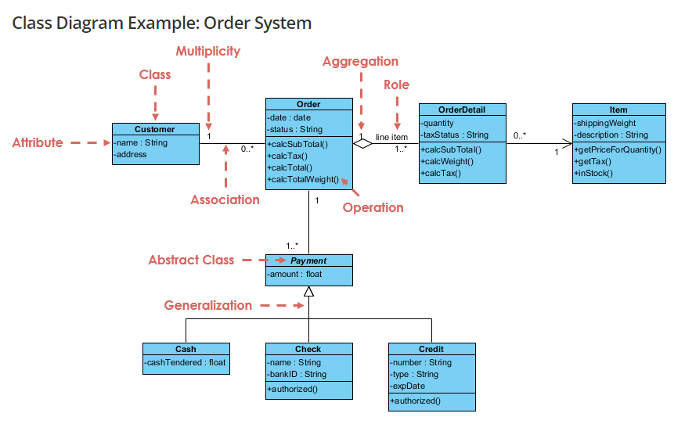
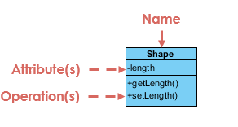
Design and Documentation and a higher level thought process
https://www.visual-paradigm.com/guide/uml-unified-modeling-language/uml-class-diagram-tutorial/

Slide 6
Tuples and Using Dictionaries to pass information around
Tuples are a very simple feature (way back in the types unit) that we can find a new use for
Python has some great, modern data structures that allow us to package up data and ship it around. Let’s explore that a bit!
Extending return value capabilities of functions
  It acts and seems as if we are returning more than one value, but instead we are indeed returning one value, but it is a collection (like a list) of an immutable type called a tuple. Immutable just means it can’t be changed after it is created. Because of this, we can use indices to get in there!
Think about applications of the mutable (changeable) list against the immutable (not changeable) tuple

Slide 7
Classes and OOP Expand this even more!
Object-oriented programming languages make it easier to understand how a program works by bringing together data and its behavior (or method) in a single bundle called an “object.” In contrast, functional programming is a model based on performing operations, or functions, on
As these are now data types we can use, we can have instances of these objects work and interact together. Think about the similarities of x = y + 27 and
fight_outcome = player1.attacks(player2). More data and complexity, but similar interactions!

Slide 8
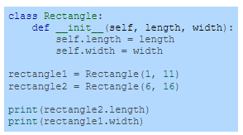
Anatomy of a class
A Class is a definition of a new type. Think of it like a blueprint you use to design the house before you build it (or a town of them!)
An OBJECT is a place reserved in memory for an INSTANCE of that CLASS. There’s a lot in this one sentence…..
Classes are defined by building up from internal methods and variables. These are called class methods and attributes (variables)
  They work the same, but are much better organized
Constructors, accessors(getters) and mutators(setters) are the first big bridges into and out of this new space.

Slide 9
